Slide 1


#Le Cube Média
Fostering a greater sense of involvement in collective activities, by facilitating the capture of contributions, content storage and their research
Greater commitment through greater automation?
Realist or idealist?
@JulienHoltzer
Co-founder and president of Pobot (robotic) and Raspberry in Blue (connected objects)

Slide 2
Usage : enregistrement RAPIDE de contributions
10-year collaboration observation:
At the end, we lose everything or we waste our time by just repeating
I have an idea
I share the idea...
… and we collaborate...
... by iterating among us
Cube's Proposition :
I have an idea
I write the idea down...
The content can be used again...
automation
… and I share it
… as well as the contribution
Support d'expérimentation #LeCubeMedia

Slide 3
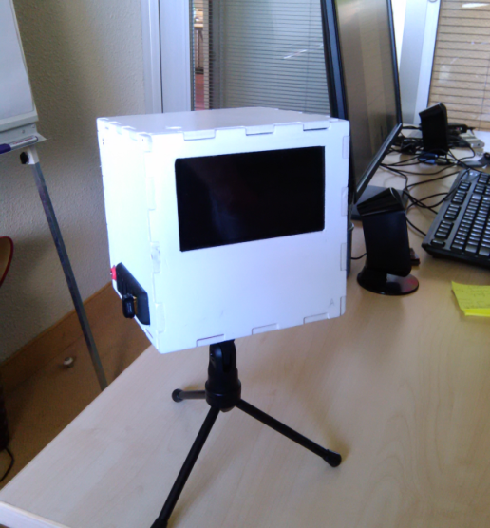

Current prototype « the Cube Media »
Demonstration: a sturdy object, extensible, open
Simple functions similar to what we can find in a smartphone but…
Always present on a desk, integrated in a workshop, in a meeting place
No ownership: a public property recognised and used by everyone
Support d'expérimentation #LeCubeMedia

Slide 4


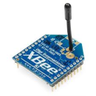
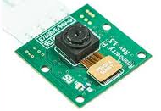



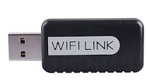

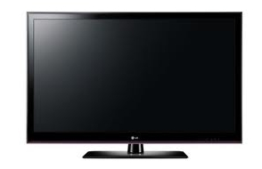

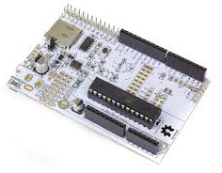
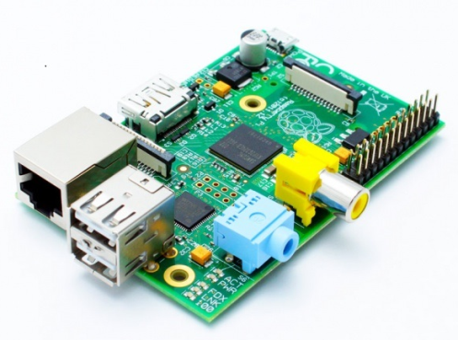
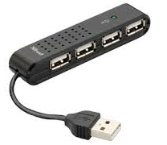



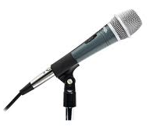
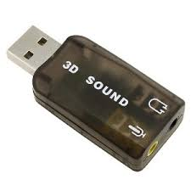
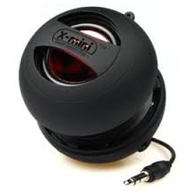
A simple device based on OPEN SOURCE CoMponents
HD camera
Bluetooth 4.0
display
USB
microphone
speaker
input adapter
#LeCubeMedia open design project – Julien Holtzer

Slide 5


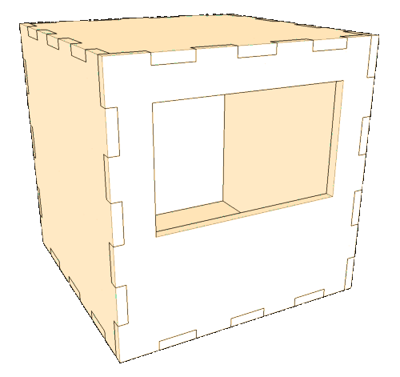
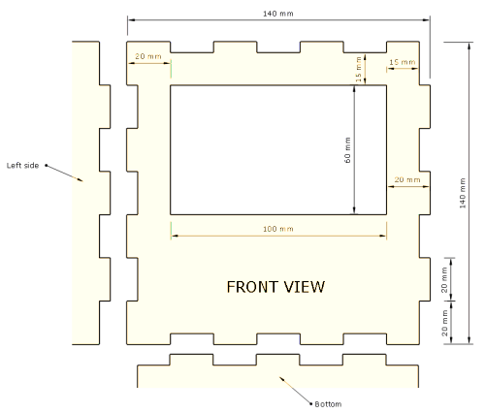
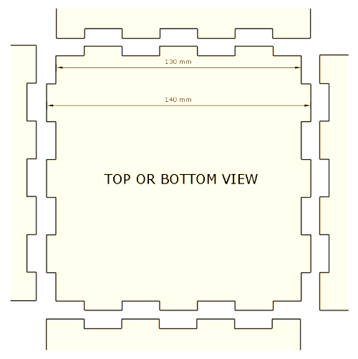
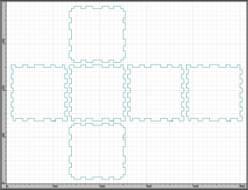
PUZZLE APPROACH : Elec, MECHA, INFO TECH
3D printing
or
Laser cutting
or
CNC milling
Support d'expérimentation #LeCubeMedia

Slide 6




















Une première étape vers de multiples services
Video-mathon
Data storage
Presentation
Multimedia recording
Grid duplication
Content access
Stock monitoring
Statistics
Communication
Access control
Credit transfer
Invoicing
Support d'expérimentation #LeCubeMedia

Slide 7
A Different approach to Creation
Initial activity
Intiale activity
Accumulation of contents
Publication
Contribution
wiki
Publication
Consultation
Consultation
The Cube : a sequence of shorter actions and a permanent publication of contents
Support d'expérimentation #LeCubeMedia

Slide 8



Licences
This presentation and concepts :
http://creativecommons.org/licenses/by-sa/2.0/fr/
Equipment et manufacturing diagrams :
http://www.oshwa.org/definition/french/
Software :
http://opensource.org/licenses/mit-license.php
Support d'expérimentation #LeCubeMedia

